Slide 1

Monday with the Mayor
April 4, 2022

Slide 2



Project analysis slide 2
Monday with the Mayor
GRAFFITI
TONIGHT’S TOPICS
SPEEDING

Slide 3
Project analysis slide 3
GRAFFITI
Monday with the Mayor
CALL
DISPATCH AT
435-882-5600
OR
REPORT
ONLINE AT TOOELECITY.ORG
NUMBER OF CASES REPORTED IN 2020
NUMBER OF CASES REPORTED IN 2021
NUMBER OF CASES REPORTED TO DATE 2022
WE NEED YOUR HELP!
PLEASE REPORT GRAFFITI OR VANDALISM!
51
59
35

Slide 4
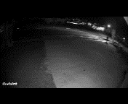
Project analysis slide 2
Monday with the Mayor
HARD TO IDENTIFY

Slide 5
Project analysis slide 2
Monday with the Mayor
$250 REWARD
Tooele City offers a $250 reward for information leading to the arrest of the person(s) responsible for graffiti or vandalism! If you have information, please contact Tooele City Police by calling Dispatch at 435-882-5600 or report it using our online reporting system at
TOOELECITY.ORG >City Departments
>Police Department >Make A Report

Slide 6
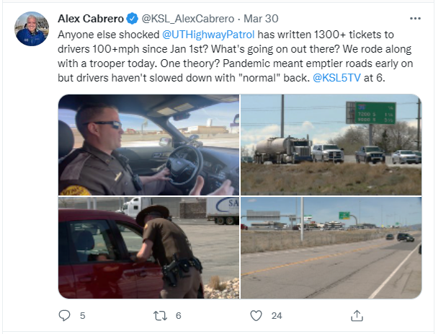
Project analysis slide 6
SPEEDING
Monday with the Mayor

Slide 7

Project analysis slide 6
SPEEDING
Monday with the Mayor
NUMBER OF LANE MILES
TO PATROL IN THE CITY
NUMBER OF PATROL
OFFICERS ON DUTY
340
20
14,019
20,663
4,041
# OF CALLS
FROM
JANUARY TO
MARCH 2022
# OF CALLS IN 2020
# OF CALLS IN 2021

Slide 8
Project analysis slide 3
SPEED SURVEYS
Monday with the Mayor
Traffic Survey Information
 | # of vehicles | Over the speed limit | 85th Percentile
Survey #1 | 8,153 | 74% | 36
Survey #2 | 13,259 | 85% | 38
Survey #3 | 20,981 | 89% | 40
Survey #4 | 31,565 | 92% | 39
Survey #5 | 10,683 | 28% | 29
Survey #6 | 17,622 | 85% | 37
Survey #7 | 13,790 | 84% | 35
Survey #8 | 21,894 | 70% | 35

Slide 9
IMPACT WHEN SCHOOL IS IN SESSION
Monday with the Mayor
Survey's Done Where T-TECH, Blue Peak, And Tooele High Students Travel (Vine Street and 1100 West)
 | Vehicles | Over 55mph | Over 75mph |  | Vehicles | Over 55mph | Over 75mph
12/21/2021 - 12/28/2021 (School Out 1100 West) | 20,981 | 33 | 24 | 12/21/2021 - 12/28/2021 (School Out Vine Street) | 8,153 | 23 | 4
1/5/2022- 1/12/2022 (School In 1100 West) | 31,565 | 218 | 72 | 12/21/2021- 12/28/2021 (School In Vine Street) | 13,259 | 70 | 18

Slide 10
Extra Speeding Enforcement Was Done on Two Days in March. This Resulted in 44 Speeding Citations.
57% of the Drivers Cited Were Over the Age of 30.
Monday with the Mayor
AGE OF DRIVERS RECEIVING CITATIONS
Age (Years) | 17 | 18-19 | 20-29 | 30-39 | 40-49 | 50-59 | 60-69 | 70-79 | 80+ | Total
Citations | 3 | 8 | 8 | 9 | 4 | 9 | 1 | 1 | 1 | 44

Slide 11
Project analysis slide 6
SPEEDING
Monday with the Mayor
44 CITATIONS WERE ISSUED DURING 2 FOUR (4) HOUR ENFORCEMENT PERIODS
AVERAGE SPEED OVER THE POSTED SPEED LIMIT FOR CITATIONS ISSUED
AVERAGE AGE OF DRIVERS WHO WERE ISSUED CITATIONS
44
14
36

Slide 12

Questions and
Discussion

Slide 13

Have questions or suggestions for topics to be discussed at our next Monday with the Mayor?
Email mondayswiththemayor@tooelecity.org

